Slide 1
Introduction
to
Postmodernism
Self- Referentiality

Slide 2

Self- Referentiality
self-reference
+ -ial
+ -ity
Notes:
Self Referentiality is a little harder to describe so let's break the work apart to see what were dealing with. What we have is two suffixes added to the term "self-reference"

Slide 3
self-reference:
“I”, “me”
Notes:
Now self-reference is simply referring to oneself. Every time you say "I" or "me" you are making a self-reference.

Slide 4
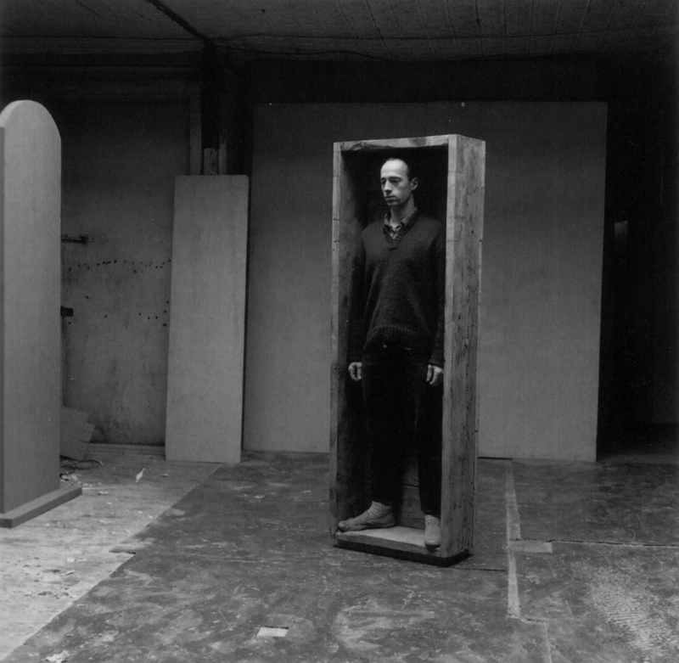
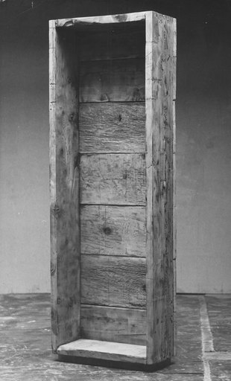
Notes:
We've already seen work that makes a self-reference, Robert Morris' Box for Standing is a self-reference. In this case it references the proportions of his own body. In fact any self portrait is a self-reference.

Slide 5
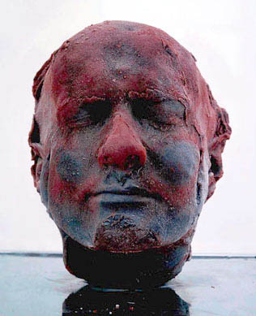
Notes:
This piece by Mark Quinn, simply titled 'Self' examines the heart of the self-reference, no pun intended. He collected his own blood over a number of months, and then froze it in a cast of his own head. So here the material itself as well as the image are both self-references, and the fragile nature of a frozen sculpture references the fragility of life itself.

Slide 6
-ial:
“of or related to”
-ity:
“state of being”
Notes:
Now "-ial" added to the end of a word creates an adjective meaning "of or related to" so self-referential simply means something is related to self-reference, and "-ity" refers to the state of being,

Slide 7
Self- Referentiality
the state of being
self-referenential
Notes:
So self-referentiality means "of or related to the state of being a self-reference", or more simply put, the "state of being self-referential". So we've seen how we can be self-referential by making a self portrait, but how can an artwork itself be in the state of being self referential?

Slide 8
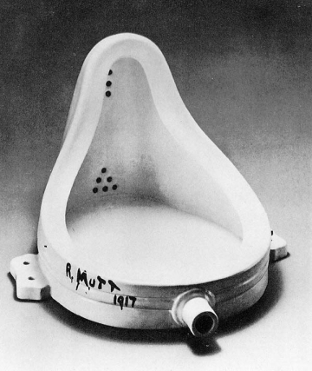
Notes:
One way is by questioning the nature of art itself. In 1917, the already famous artist Marcel Duchamp signed a urinal R.Mutt, titled it "Fountain", and submitted the piece to an art show who's rules stated all works would be accepted for exhibition as long as the artist paid the fees. The curators refused to exhibit the work after deciding it wasn't art, but the piece has lived on through the questions it raised about 'what is art?'

Slide 9
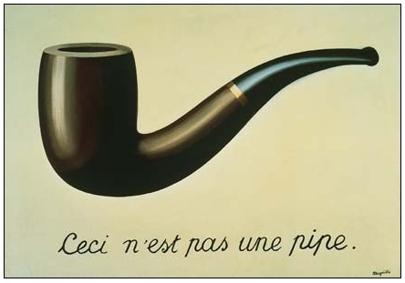
Notes:
René Magritte made this piece, titled "The Treason of Images" in 1928. It is a painting of a pipe, with the word's painted below "ceci n'est pas une pipe", "This is not a pipe." This apparent contradiction points out that a painting of a pipe is only a reference to a pipe, not a pipe itself. By painting these words in the artwork itself, Magritte has made a painting that is in the state of being self-referential.

Slide 10
You are about to begin reading Italo Calvino’s new novel, If on a winter’s night a traveler. Relax. Concentrate. Dispel every other thought. Let the world around you fade. Best to close the door, the TV is always on in the next room. Tell the others right away, “No, I don’t want to watch TV!” Raise your voice--they won’t hear otherwise-- “I’m reading! I don’t want to be disturbed!” Maybe they haven’t heard you with all that racket; speak louder, yell; “I’m beginning to read Italo Calvino’s new novel!” Or if you prefer, don’t say anything; just hope they leave you alone.
Italo Calvino--If on a Winter’s Night a Traveler. 1979
Notes:
Italo Calvino wrote a novel in 1979 titled "If on a winter’s night a traveler". You can stop the slideshow right here and read the first paragraph of the novel if you'd like. It starts off by describing you, the reader as you are reading the novel. In fact the novel mentions itself in the first line: "You are about to begin reading Italo Calvino's new novel, If on a winter's night a traveler." We have entered self-referentiality here because the novel is aware that it is a novel, it knows it's own name, it even knows it's being read!

Slide 11
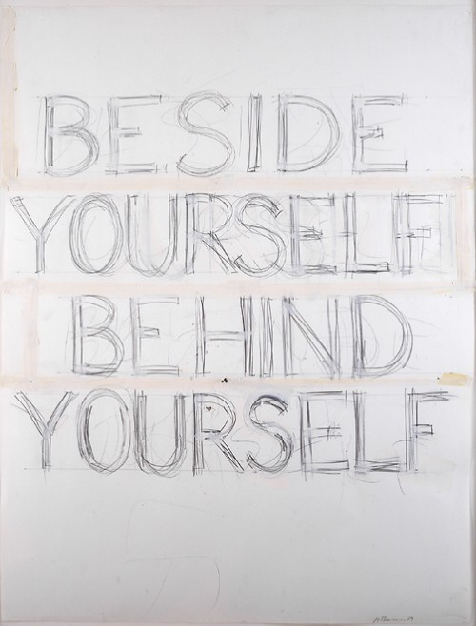
Notes:
Part of what makes self-referentiality so fascinating to us, is we as humans often debate whether we are the only beings who have a concept of self. Plenty of studies have been done to examine if other intelligent mammals are self-aware. Do you remember what it was like when you first started to understand that "you" were somebody, that someday you would die? Living in self-referentiality is something that we continue to come to terms with throughout our lives.

Slide 12
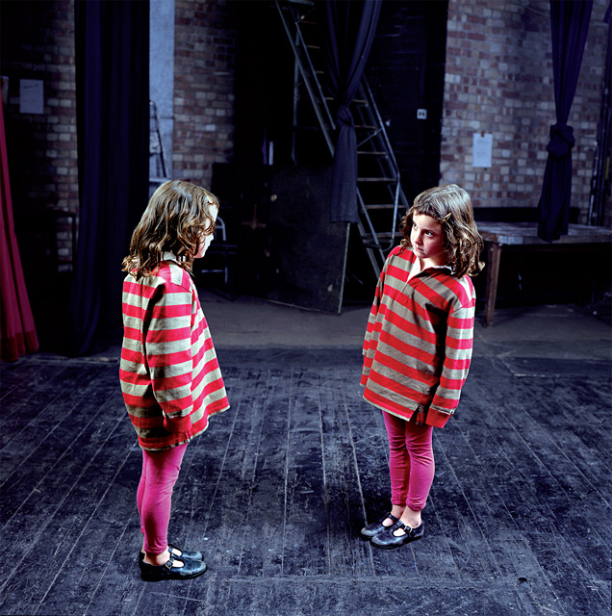
Notes:
Confronting ourselves means trying to imagine what it is like to see ourselves from the outside.

Slide 13
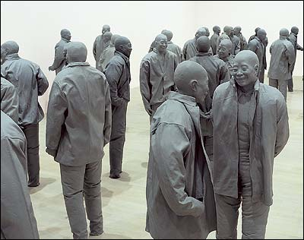
Notes:
Sometimes this inner reflection begins to feel like a hall of mirrors. We can only imagine what it is like to be another compared to what it is like to be ourself.

Slide 14
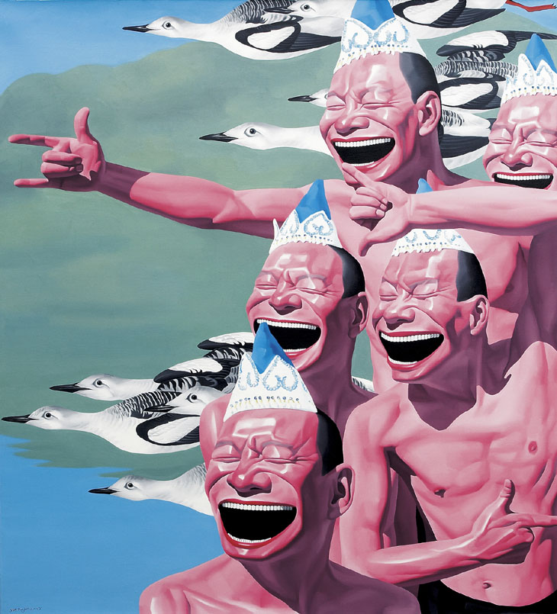
Notes:
The face that you put forward is what makes you you to anyone else. Just as we try to imagine the world outside of ourselves, we are continually trying to communicate what life is like inside our own experience. This self-referential communication is the glue that holds our social species together, and this is why artists return to it again and again.

Slide 15
Images:
Robert Morris, Box For Standing, 1961
Marc Quinn, Self, 1991
Marcel Duchamp, Fountain, 1917
René Magritte, The Treason of Images, 1928
Italo Calvino, If on a Winter’s Night a Traveler, 1979
Bruce Nauman, Beside Yourself Behind Yourself, 1989
Wendy McMurdo, Helen Backstage Merlin Theatre, 1996
Juan Muñoz, Many imes (Detail), 1999
Yue Minjun, Untitled, 2005
Notes:
Robert Morris, Box For Standing, 1961
Marc Quinn, Self, 1991
Marcel Duchamp, Fountain, 1917
René Magritte, The Treason of Images, 1928
Italo Calvino, If on a Winter’s Night a Traveler, 1979
Bruce Nauman, Beside Yourself Behind Yourself, 1989
Wendy McMurdo, Helen Backstage Merlin Theatre, 1996
Juan Muñoz, Many imes (Detail), 1999
Yue Minjun, Untitled, 2005

